Slide 1
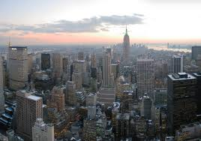
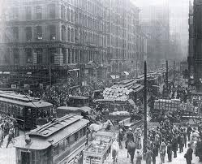
Rise of American Industrial Might
After the Civil War the United States becomes the #1 Industrial country in the world with New York City becoming the #1 trade city

Slide 2
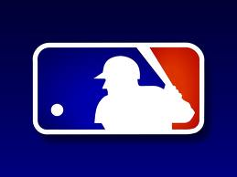
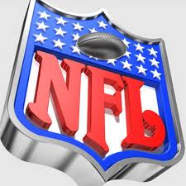
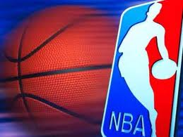
How do Corporations eliminate competition
Monopoly—a company that has complete control over competition

Slide 3
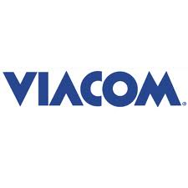
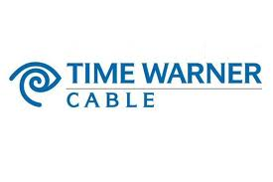
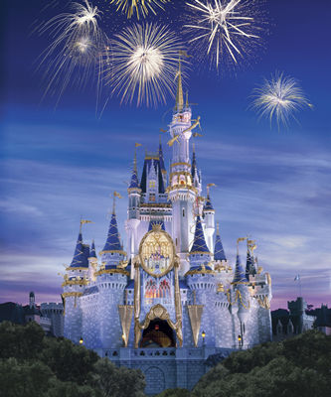
2. Conglomerate
A corporation that owns unrelated companies
http://www.ask.com/wiki/List_of_Procter_%26_Gamble_brands

Slide 4
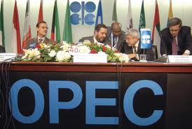
3. Pool
When competing companies decided to fix prices
Railroads were notorious for this during the late 1800s

Slide 5
4. Trust
Group of corporations that combine under a single board of trustees

Slide 6
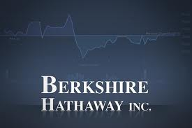
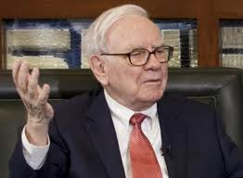
5. Holding Company
When companies buy stock in different corporations
Example would be Berkshire Hathaway which owns
Buffalo News
Geico
Dairy Queen

Slide 7
Entrepreneurs
Entrepreneurs are individuals who risk large sums of capital ($) in hopes of making enormous profits
Americas biggest entrepreneurs were:
Andrew Carnegie
John D. Rockefeller
JP Morgan
Henry Ford

Slide 8
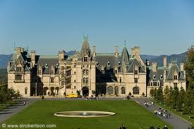
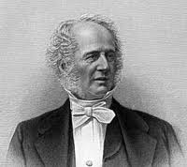
Cornelius Vanderbilt
Railroad tycoon
Began his empire by creating railroads in New York
http://www.history.com/shows/men-who-built-america/videos/the-men-who-built-america-competitive-nature#the-men-who-built-america-competitive-nature

Slide 9
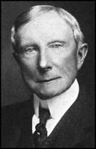
John D. Rockefeller
Owned Standard Oil Company (90% of the oil refineries)
Destroyed competition by under cutting prices and eliminating competition (horizontal integration)
http://www.history.com/videos/john-d-rockefeller-oil-money-and-power#john-d-rockefeller-oil-money-and-power

Slide 10
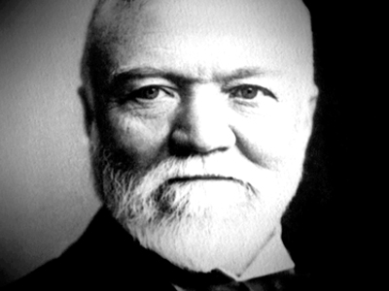
Andrew Carnegie
Scottish immigrant
Epitome of the American dream
Created Carnegie Steel Corporation
Utilized the idea of Vertical Integration
http://www.history.com/videos/andrew-carnegie-and-the-homestead-strike#andrew-carnegie-and-the-homestead-strike

Slide 11
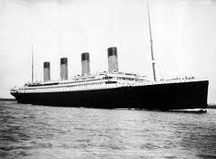
JP Morgan
JP Morgan was a banker who would buy failing companies and reorganize them to make a profit
Morgan bought Carnegies Steel in 1901 and merged it to create U.S. steel
http://www.history.com/videos/john-d-rockefeller-oil-money-and-power#jp-morgan-battles-coal-miners-in-1902

Slide 12
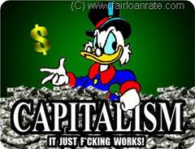
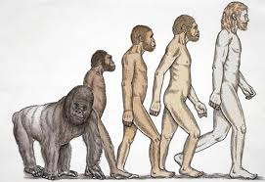
Why the wealthy flourished
Laissez Faire
Government should not interfere with business
Social Darwinism
“Survival of the Fittest”

Slide 13
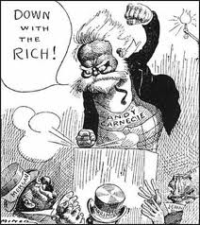
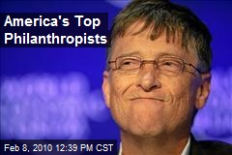
Were these men “Robber Barons” or Philanthropists
Robber Baron
Philanthropist
People who gained their wealth at the expense of the poor
Many famous entrepreneurs began donating large sums of money to help society (i.e.: schools, libraries, museums, etc.

Slide 14
What was The Governments role?
Munn vs. Illinois
Supreme Court ruled that states can control grain elevator prices
Wabash vs. Illinois
Only the federal government can control railroad rates
Interstate Commerce Commission
Ended railroad companies abilities to form pools and favored rebates
Sherman Anti Trust
Prohibited any monopolies and business that “restrained trade”

