Slide 1
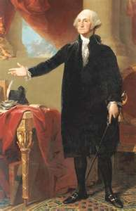
The states were held together by a “rope of sand.”—George Washington referring to the “Critical Era”
“The Critical Era”
1781-1789

Slide 2
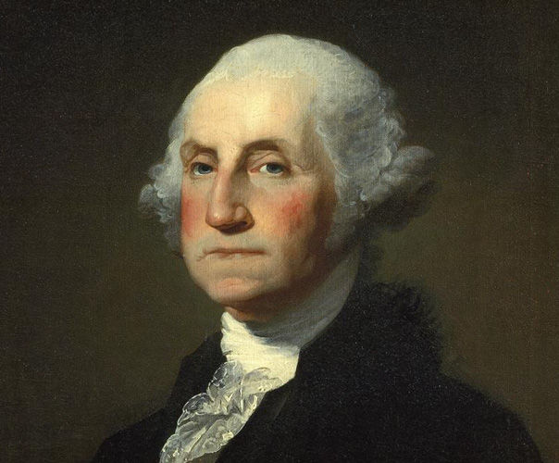
George Washington
Only unanimous choice for President (Twice)
Won in 1788 and 1792
Many of the precedents we have today were started by President George Washington
Cabinet—group of advisors chosen by the President, then confirmed by the Senate (Unwritten Constitution)
1st cabinet included a whose who of politics

Slide 3
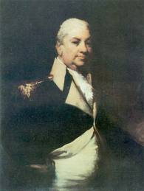
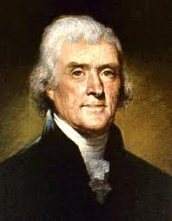
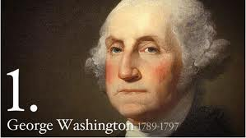
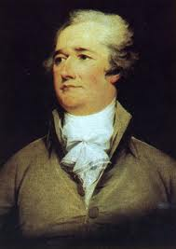
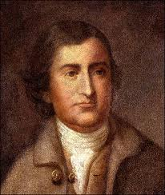
Sec. of War
Henry Knox
Sec. of State
Thomas Jefferson
Attorney General
Edmund Randolph
Sec. of Treasury
Alexander Hamilton

Slide 4
Birth of American political parties
Alexander Hamilton
Thomas Jefferson
Federalist
Loose Interpretation
Pro-British
Large Peacetime Army
Pro business
Pro National banks and tariffs
Supported by large business owners and manufacturers
Feared anarchy
Democratic Republican
Strict Interpretation
Pro-French
Small peacetime Army
Pro agriculture
Opposed national banks and tariffs
Supported by Southern and Western plantation owners
Feared tyranny

Slide 5
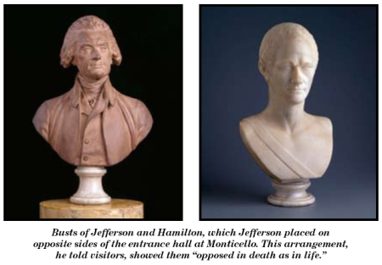

Slide 6
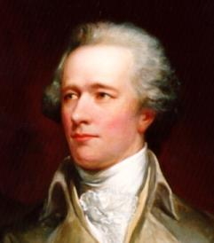
Alexander Hamilton
Secretary of Treasury Hamilton’s main job was to create a strong economic base for the new country
Hamilton's plan included 4 main parts
Federal gov’t assumes states war debts
Protective Tariff
Excise Tax on whiskey
National Bank
Anti Federalist disagreed with Hamilton’s plan because it favored the wealthy and there was no mention of it in the Constitution

Slide 7
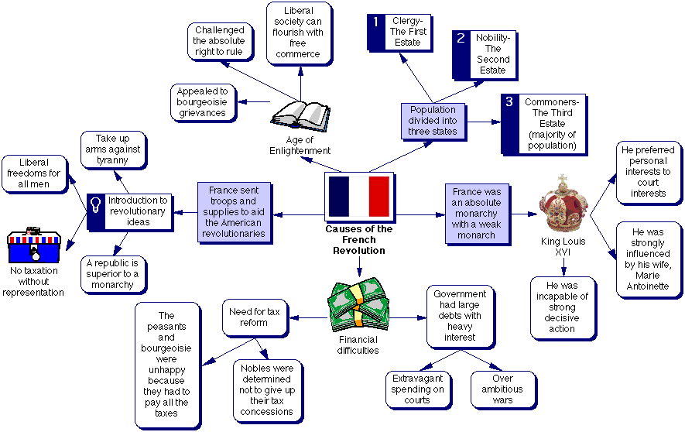
Foreign Problems for Washington
French Revolution
Who does America side with?
The French people? 2. The French gov’t?

Slide 8
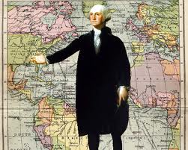
Washington responds
Proclamation of Neutrality 1793
Washington says our young nation is not strong enough to engage in a European War

Slide 9
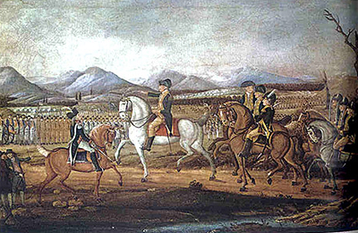
Whiskey Rebellion
PA farmers refused to pay the federal excise tax on whiskey by attacking revenue collectors (IRS today)
Pres. Washington federalizes 15,000 militiamen and places them under Alexander Hamilton’s command
What were the results of Washington ordering the troops to Western PA?

Slide 10
Washington’s Farewell
President Washington, with the assistance of Alexander Hamilton, warned his new country to refrain from:
European affairs
Forming permanent alliances
Forming political parties
Sectionalism

Slide 11
Washington’s Legacy
Greatest President ever???
Cabinets
Voted unanimously twice
The presidency was created for him
“Mr. President”
Vermont, Kentucky and Tennessee enter the U.S.
Nominated 14 Supreme Court justices (Most all time)
Voluntarily left office after 2 four year terms
How would the U.S. have been different if Washington never took the oath of office?

